Slide 1
End-to-End Machine Learning with ML.NET and Azure
CodeCampNYC 2018
Luis Quintanilla

Slide 2
Hello
Consultant
Interests: Artificial Intelligence, IoT and all things .NET
GitHub: lqdev
Twitter: @ljquintanilla
Blog: luisquintanilla.me

Slide 3
Agenda
What is Machine Learning?
From Data to Machine Learning
Building a Model
Deploying a Model

Slide 4
What is Machine Learning?

Slide 5
Artificial Intelligence vs Machine Learning
Artificial Intelligence
Machine Learning
Notes:
AI
Automating tasks usually performed by humans
Rules-Based Systems/Symbolic Programming
Example: If-Then
Machine Learning
Finding useful data representations within a predefined space
Example: Linear Regression

Slide 6
What can you do with Machine Learning?
Supervised Learning
Unsupervised Learning
Regression
Classification
What is the price of a home in NYC?
Is this a dog or a cat?
Clustering
What kinds of topics are present in this document database?

Slide 7
Binary Classification Example
Training Data
New Data
Species | Is Independent | Class
Canine | False | Dog
Feline | True | Cat
Feline | True | Cat
Canine | False | Dog
Canine | True | Dog
Species | Is Independent
Canine | False
Prediction
Samples
Targets
Class
Dog

Slide 8
From Data to Machine Learning

Slide 9

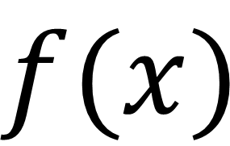
What is a model?
True
$$f(x)$$
False
Input
Model
Output

Slide 10
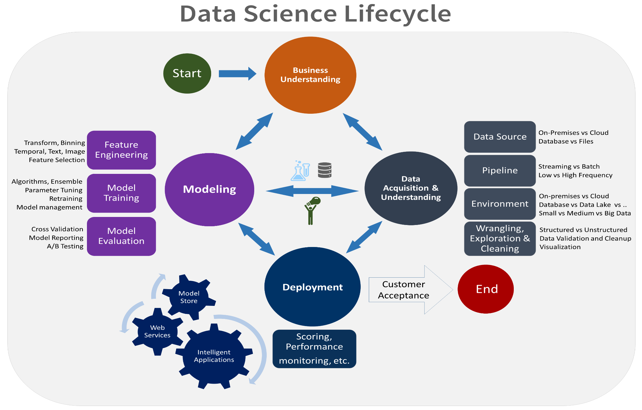
The Machine Learning Process

Slide 11
Building a Machine Learning Model

Slide 12
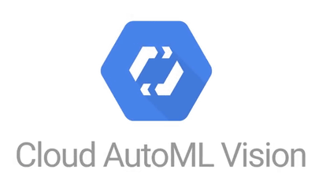

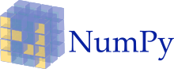

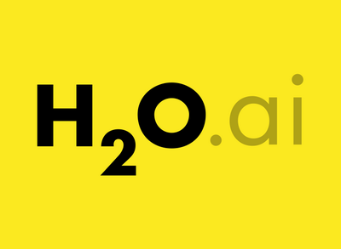

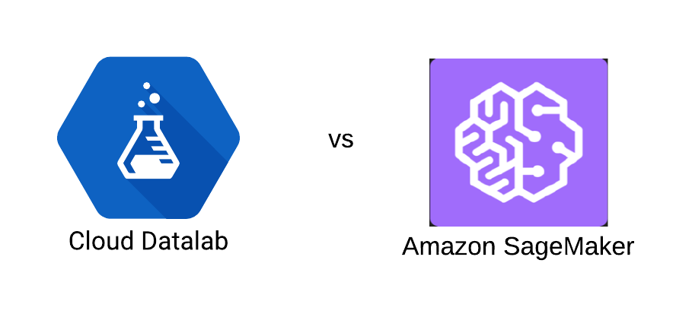




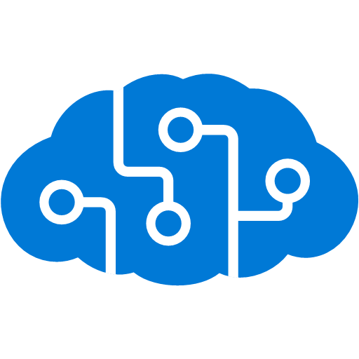


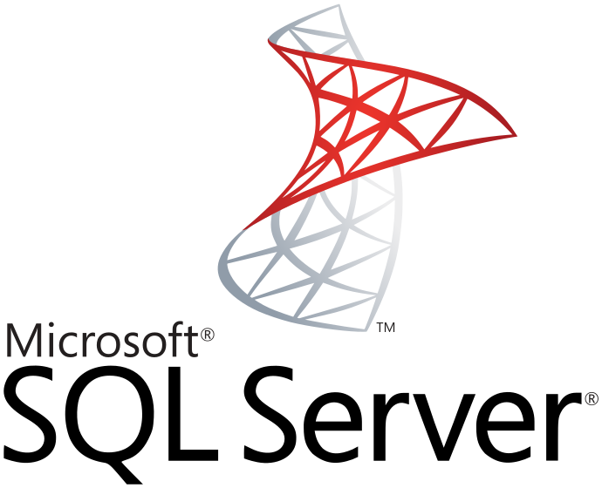

Machine Learning Tools

Slide 13



Automated vs. Custom
Automated
Custom

Slide 15

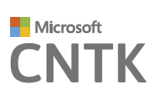
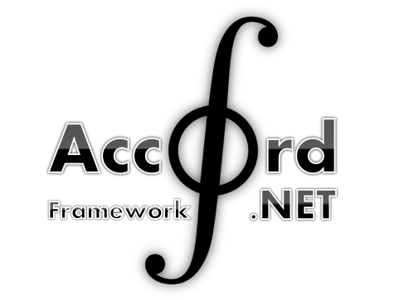

.NET Machine Learning Tools

Slide 16
ML.NET
Framework for custom Machine Learning
.NET Standard
Proven & Extensible
Open Source
Cross Platform

Slide 17
What can you do in ML.NET?
Transformations
Missing Values
Feature Selection
Learners
SVM
K-Means
Misc
Data Loaders
Evaluators
Extensions
Normalization
Boosted Trees
TensorFlow
CNTK
ONNX
Accord.NET
Notes:
Build and train ML.NET Models
Run ANY Model

Slide 18
Iris Classification Model
Class Library
Azure
Model
Azure Container Instances Application
Azure Functions Application
Console Application

Slide 19
Demo: Training a Model

Slide 20
Consuming a Machine Learning Model

Slide 21
How Can I Consume My Model
Desktop
Mobile
Web
IoT
Wherever .NET Runs*

Slide 22
Deploying to the web
VM
Always On
Manage machines
Containers
Always On
Manage Clusters
Serverless
Consumption Based
Manage Services/Logic
Notes:
https://dzone.com/articles/virtual-machines-vs-containers-vs-serverless-compu

Slide 23
Demo: Deploying a Model to Azure

